Slide 1

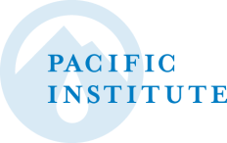
President’s Report:
Pacific Institute Q3 2018 Board Meeting
Jason Morrison, President
Pacific Institute
September 19, 2018

Slide 2
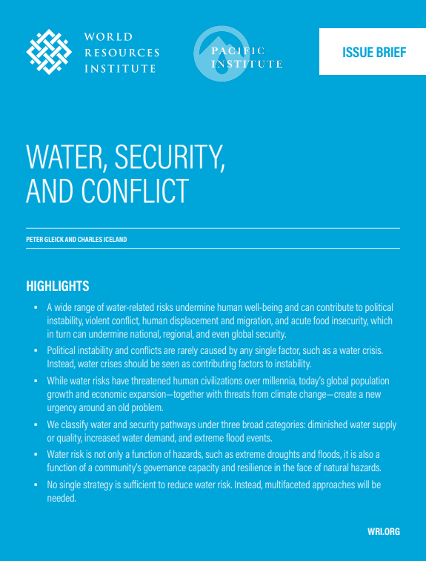
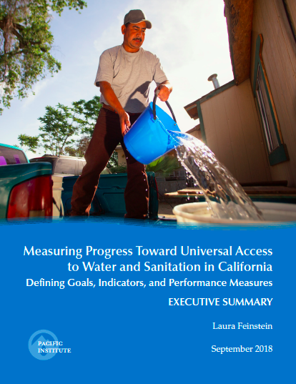
Publications Since June 2018
Stormwater Capture Opportunities in California
United Nations SDG 6 Synthesis Report 2018 on Water and Sanitation (Pacific Institute/CEO Water Mandate chapter contributor)
Measuring Progress Toward Universal Access to Water and Sanitation in California
Water Security, Conflict, and Migration
Integrating Water Efficiency into Long-Term Demand Forecasts
Transitions to Freshwater Sustainability

Slide 3
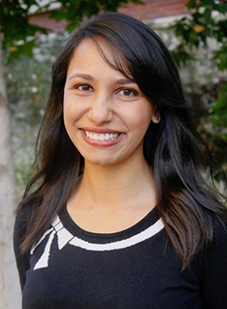
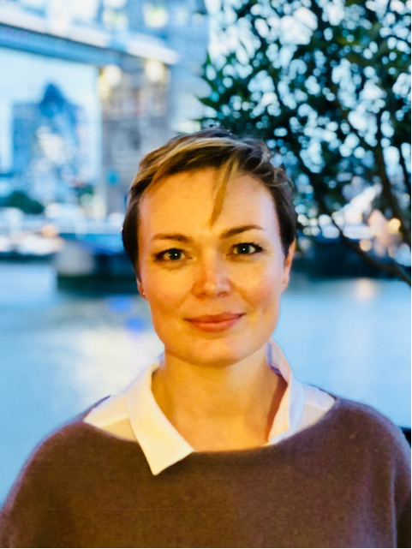
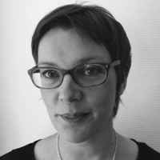
New Pacific Institute Hires
Sonali Abrams (Research Associate): Full time hire, based in Oakland, focusing on California water issues
Karina de Souza (Senior Researcher): Full time hire, based in London, focusing on corporate water stewardship issues; Co-Lead Water Protocol project
Amy Herod, PhD (Senior Researcher): 60% time hire, based in Paris, focusing on corporate water stewardship issues; Co-Lead Water Protocol project

Slide 4
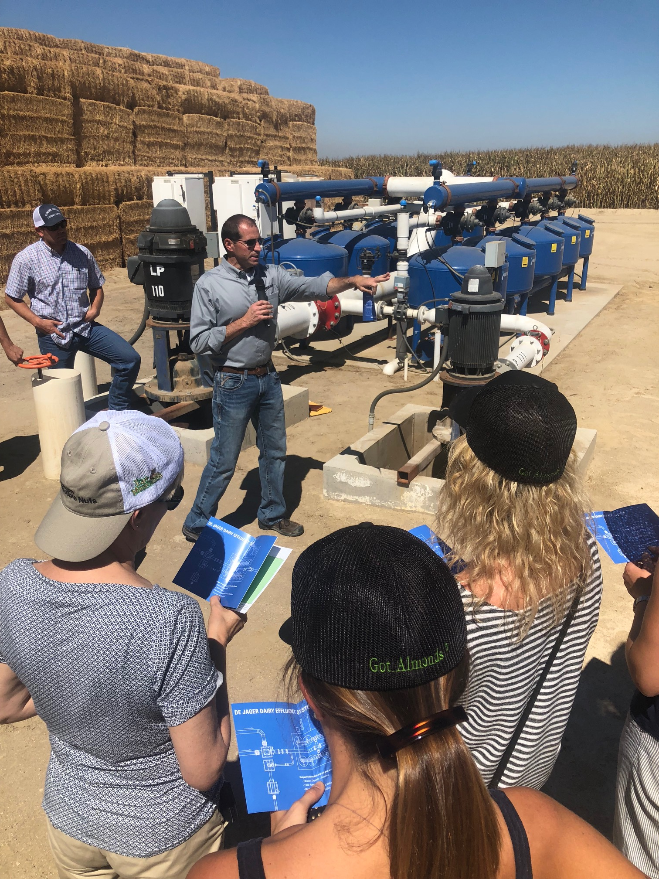
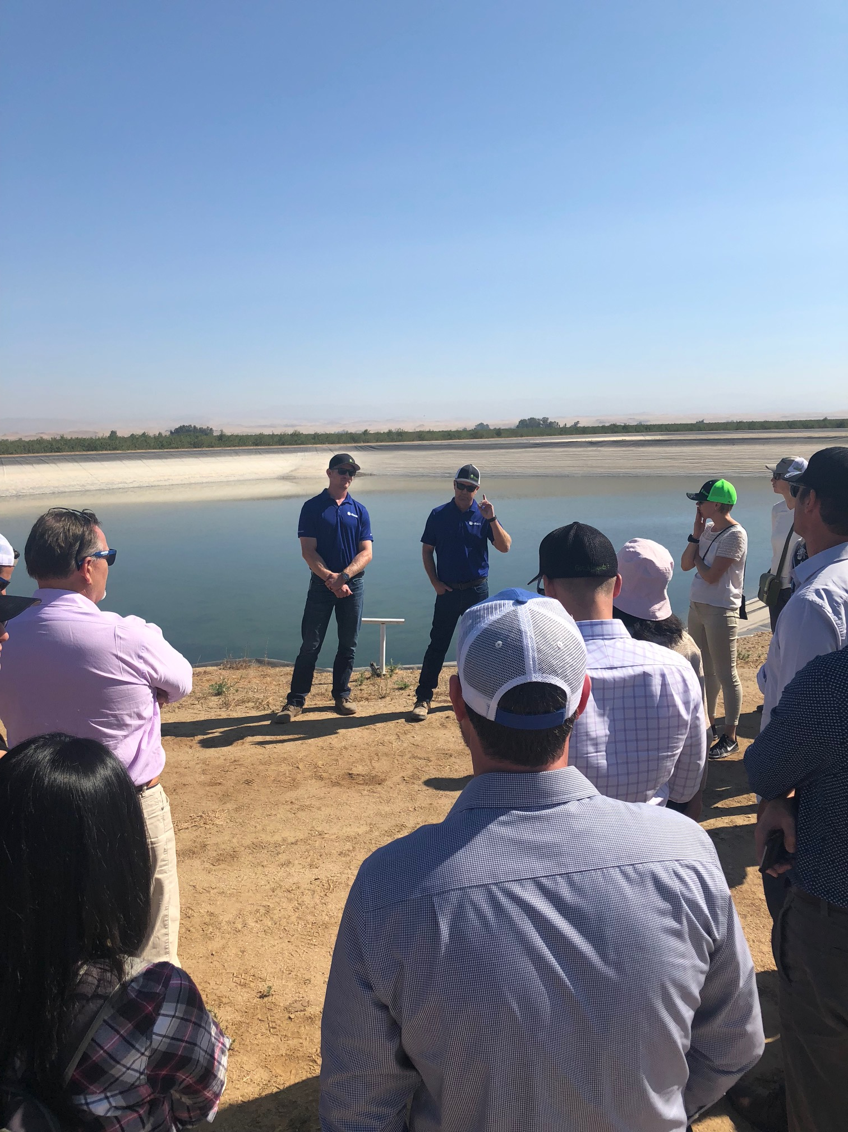
Bringing Knowledge to Power
UN Principles for Responsible Investment – Over 2000 signatories with more than USD $80 Trillion in assets under management
California water tour for 30+ PRI Water Working Group members

Slide 5
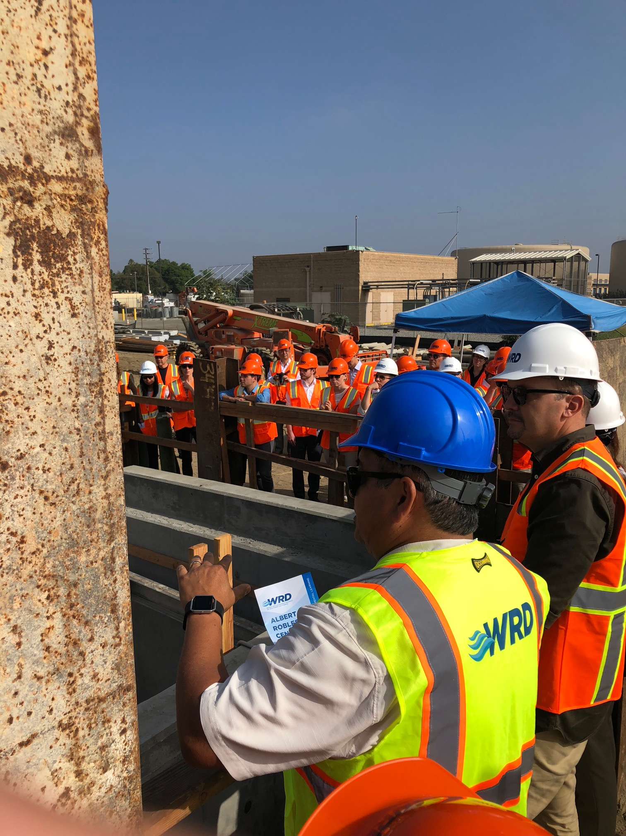
Bringing Knowledge to Power
Select organizational representation:
  Ontario Teachers' Pension Plan (Canada)
  PGGM Investments (Netherlands)
  Robeco (Netherlands)
  Fidelity Asset Management (USA)
  State Street Corporation (USA)
  Sompo Japan Nippon Asset Management Co. (Japan)
  Sumitomo Mitsui Trust Bank, Ltd (Japan)
  AMP Capital Investors (Australia)
  Swedish Seventh National Pension Fund (Sweden)
  Canada Pension Plan Investment Board (Canada)
  Church Pension Fund (Finland)
  Council on Ethics Swedish National Pension Funds (Sweden)
  ERAFP - Etablissement de Retraite Additionnelle de la Fonction Publique Pension Scheme (France)
  Fonds de réserve pour les retraites (France)
  Neuberger Berman Group LLC (USA)

Slide 6
Emerging Pacific Institute Partnerships
Global Water Partnership – Thought leadership in conceptually aligning corporate water stewardship with IWRM (water sector practitioners); country-level multi-stakeholder convenings
UCLA Luskin Center – Working to develop a water optimization model for water trading opportunities in California; promote uptake of unconventional water supply
World Resources Institute – Normative guidance on corporate water target setting; open source online platforms (i.e., Water and Conflict; Public Sector Water Management Atlas); river basin scenario tool
The Nature Conservancy – Connecting TNC Water Funds to UN Global Compact in-country collective action initiatives and the Water Action Hub; quantification of climate/carbon benefits associated with watershed investments

Slide 7
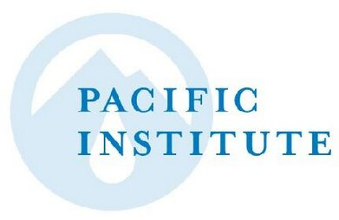
Strategic Plan Working Definitions
Goals: Broad, aspirational, value-laden concepts focused on the contours of water sustainability
Objectives: More detailed ways in which the Institute links our work to the goals, and the contributions we’re making to achieving them
Focus Areas: Specific areas of programmatic focus and the mechanism through which we organize research staff and develop and execute thematic strategies. Trans-sectional, spreading across multiple goals, and mostly for internal use
Impact Pathways: Functional modalities for achieving objectives

Slide 8
Mission: Create and advance solutions to the world’s most pressing water challenges
Water Sustainability Goals
Safe, affordable, accessible water and sanitation for all
Integrated and cooperative water resource management at all levels
Climate-resilient urban, industrial, and agricultural systems within the limits of available water
Healthy aquatic and riparian ecosystems
Programmatic Objectives
See board packet for draft objectives
pacinst.org | @PacificInstitut

Slide 9
Provisional “Impact Pathways”
Research and Analysis: Analyze and synthesize data and information to inform decision making and operational activities
Multi-Stakeholder Convenings and Collaborations: Convene stakeholders, leverage partnerships, and facilitate knowledge-sharing and cooperation
Strategic Advice and Technical Assistance: Provide strategic advice and technical assistance for water planning, management, and evaluation
Policy Advocacy: Advocate for policies to embed sustainability into water planning, programs, and budgeting
pacinst.org | @PacificInstitut

Slide 10
Strategic Planning Roadmap
Phase | Timeline
Defining/Scoping Programmatic Priorities | Q1-Q2
Mapping Impact Pathways; Operational Strategies | Q3
Finalizing the Plan | Q4
In progress
?? (Relates to BHAG decision)
pacinst.org | @PacificInstitut

Slide 11
Strategic Initiative: Setting a Long-Term Organizational Goal
OPTIONS
Stay the course – Continue with business as usual; no BHAG
Defer until next strategic plan – Finish strategic plan under development and pick up the BHAG idea for our next strategic planning period (i.e., 2023 or earlier?)
Extend planning process to include BHAG – Late 2019 completion
Hybrid approach – “Finalize” current strategic plan by 2018; develop BHAG and incorporate into plan by the end of 2019
Staff preference

