Slide 1


President’s Report:
Pacific Institute Q2 2018 Board Meeting
Jason Morrison, President
Pacific Institute
June 6, 2018

Slide 2
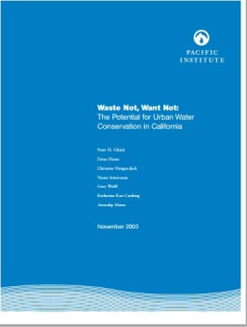
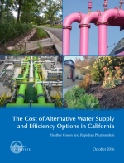
Applied Research Leading to Real-World Impacts
Numerous assessments showing that conservation and efficiency are the largest, least expensive water supply option in California:
  Waste Not, Want Not (2003)
  California’s Next Million Acre-Feet (2010)
  Untapped Potential of California’s Water Supply (2014)
  Cost of Water Supply and Efficiency Options (2016)
Assembly Bill 1668 and Senate Bill 606 establish water efficiency goals for urban water suppliers in California, similar to energy and fuel efficiency standards
Director of Research, Heather Cooley, worked closely with a coalition of NGOs, companies, and water utilities; the bills’ authors; state agency staff; and the Governor’s office to provide substantive input on the bills’ language
June 2018, Governor Jerry Brown signs legislation to strengthen water efficiency and drought planning in California

Slide 3
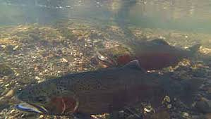
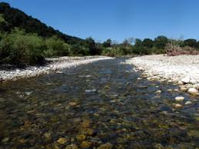
Applied Research Leading to Real-World Impacts
Interest in designating sections of the upper Mokelumne River and North Fork Mokelumne as Wild and Scenic
Local water utilities opposed this designation, arguing they needed more water from the river
In 2017, the Foothill Conservancy asked Pacific Institute to evaluate regional water demand projections
In 2018, the state recommended that 37 miles of the Mokelumne River receive Wild and Scenic designation

Slide 4

Strategic Plan Working Definitions
Goals: Broad, aspirational, value-laden concepts focused on the contours of water sustainability
Objectives: More detailed ways in which the Institute links our work to the goals, and the contributions we’re making to achieving them
Focus Areas: Specific areas of programmatic focus and the mechanism through which we organize research staff and develop and execute thematic strategies. Trans-sectional, spreading across multiple goals, and mostly for internal use
Impact Pathways: Functional modalities for achieving objectives
pacinst.org | @PacificInstitut

Slide 5
Mission: Create and advance solutions to the world’s most pressing water challenges
Water Sustainability Goals
Safe, affordable, accessible water and sanitation for all
Integrated and cooperative water resource management at all levels
Climate-resilient urban, industrial, and agricultural systems within the limits of available water
Healthy aquatic and riparian ecosystems
Programmatic Focus Areas
Corporate Water Stewardship
Prospective Focus Areas
Climate and Water
Safe and Affordable Water
Water Quality; Beneficial Reuse
California
pacinst.org | @PacificInstitut

Slide 6
Illustrative “Impact Pathways”
Normative support
Policy/strategic advice and thought leadership
Data collection and analysis
Capacity development and technical assistance
Convening of stakeholders
Direct support and service delivery
pacinst.org | @PacificInstitut

Slide 7
Strategic Planning Roadmap
Phase | Timeline
Defining/Scoping Programmatic Priorities | Q1-Q2
Mapping Impact Pathways; Operational Strategies | Q3
Finalizing the Plan | Q4
pacinst.org | @PacificInstitut

Slide 8





2018 Organizational Goals
GROWTH
Create Sustainable Growth
Increase the organization’s reach and impact
BRAND
Strengthen External Profile
Improve Institute visibility and expand external relationships/partnerships
Objective: Description:
Objective: Description:
GOAL | TARGET
Develop 2019-2023 strategic plan for the Institute | Q4 2018
Expand research staff | Net 3 FTEs (~15 total)
Hire Director of Development and Director of Communications (Subject to securing sufficient unrestricted financial resources) | DD Q2 2018 DC Q4 2018
Support Institute board expansion | 3 members
GOAL | TARGET
Redesign/launch Pacific Institute website | Q2 2018
Launch (and begin implementing) flagship institutional partnership with Swiss Development Corporation (SDC) to expand reach and impact | Q2 2018
Develop system for better measuring and communicating organizational success and impact | Q4 2018
FINANCIALS
Improve Financial Condition
Increase 2017 annual operating budget by 15 percent with no deficit
ORGANIZATION
Objective: Optimize the Organization
Description: Improve productivity/address needs relating to HR, internal systems, professional advancement
Objective: Description:
GOAL | TARGET
Establish at least one new partnership that results in programmatic funding | 1 partnership
Build and maintain an unrestricted fund reserve equal to 3 months of yearly operating budget | Approx. $600K
Ensure equal or larger income pipeline on a weighted basis at end of 2018 compared to current end of 2017 pipeline | Approx. $1.3M probable and possible
Balanced annual operating budget | $ 2.35M
GOAL | TARGET
Increase utilization rates for junior research staff to 75%, senior research staff to 70% and communications staff to 50% | Q4 2018
Transition research team structure vis-à-vis Director of Research overseeing appointed Focus Area Leads | Q3 2018
Design and implement expanded professional development program | Q4 2018
Formalize and augment internal processes, including completion of employee handbook | Q3 2018

