Slide 1


Pacific Institute
Financial Summary
Prepared for PI Board of Directors
June 6, 2018

Slide 2
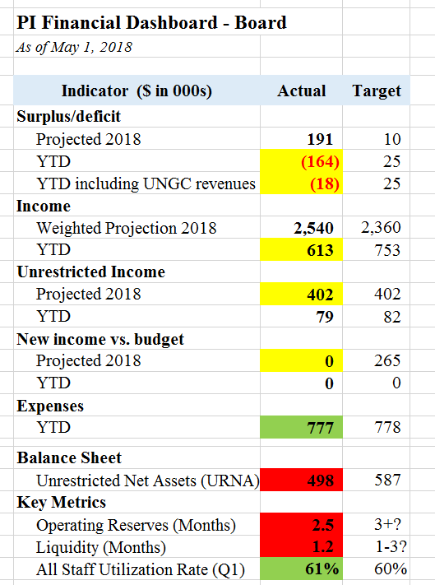
Notes:
Positives:
Expenses in check
Utilization rate up
On target for surplus for the year (as long as we raise at least $100-200K more in New Income)
$1.8M of $2.3M budget already assured.
Challenges:
UNA has decreased significantly over past year+ as a result of the 2017 deficit
Operating Reserves and Liquidity in danger zone
YTD income less than anticipated (mostly due to delays)
No room to miss on Unrestricted Income target (unexpected leaves, $ for DD)

Slide 3
Change to Investment Allocation
Current Allocation (as of May 1):
Cash: $258,647
Investments (Mutual Funds): $244,147
Total Cash and Investments: $502,794 ($405,209 in Legacy Fund)
% in Investments: 48.6%
Proposed Allocation:
Cash: $377,095
Investments (Mutual Funds): $125,699
Total Cash and Investments: $502,794 ($125,699 in Legacy Fund)
% in Investments: 25%

Slide 4
2017 Investment Summary
Mutual Fund Balance:
January 1, 2017: $204,746
December 31, 2017: $242,424
18.4% Increase in 2017
80.2% Increase over 5 years (2013-2017)

Slide 5
Status of Development Director Hire
Original Plan: Carry out DD hire in spring
Decrease in Operating Reserves has made this not possible to date
Management considering reallocating funds from Program Grants/Contracts to cover cost (increasing amount in overhead we take from program funding)
Rethinking position as Development Coordinator instead of Director

Slide 6
Finance Committee Goals
June: Dashboard Update
Sept: Recommended operating reserve policy and target
Dec: Liquidity policy and Update of Investment Policy

